Slide 1
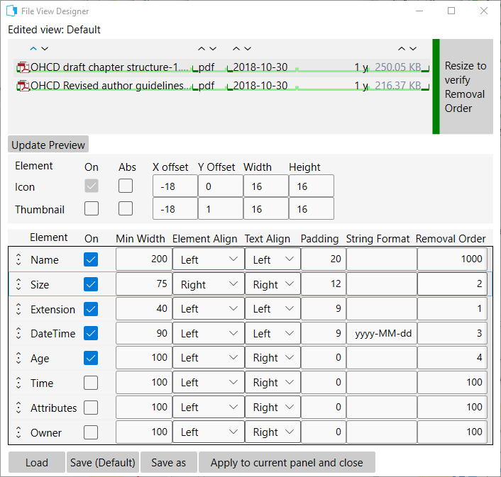
1
2

Slide 2
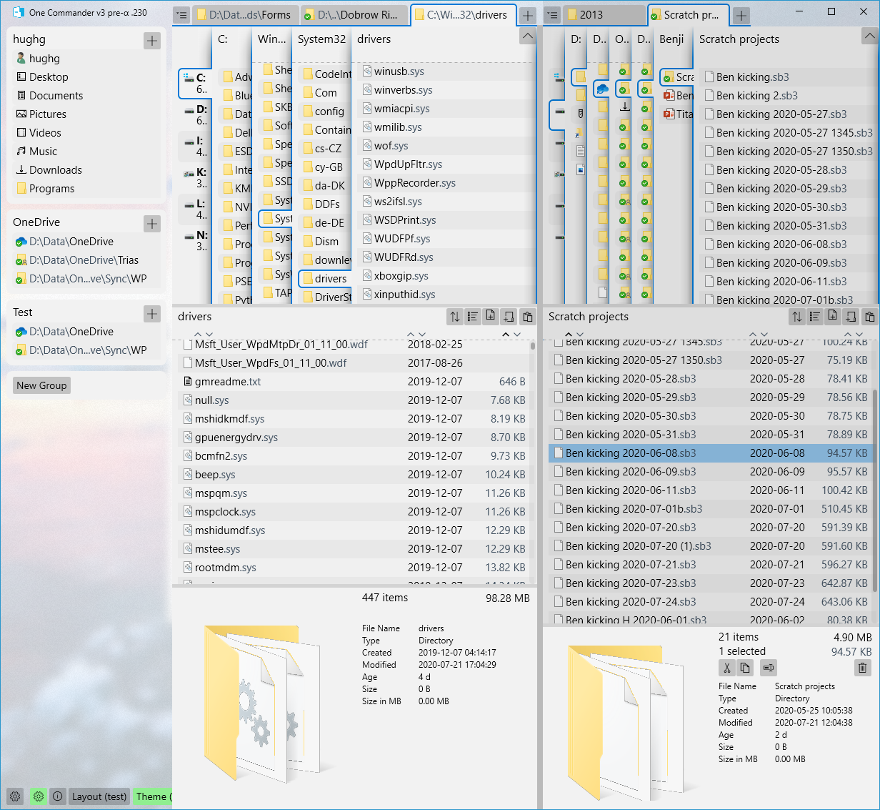
Favorites Sidebar
Left Browser
Right Browser
Layout Button

Slide 3
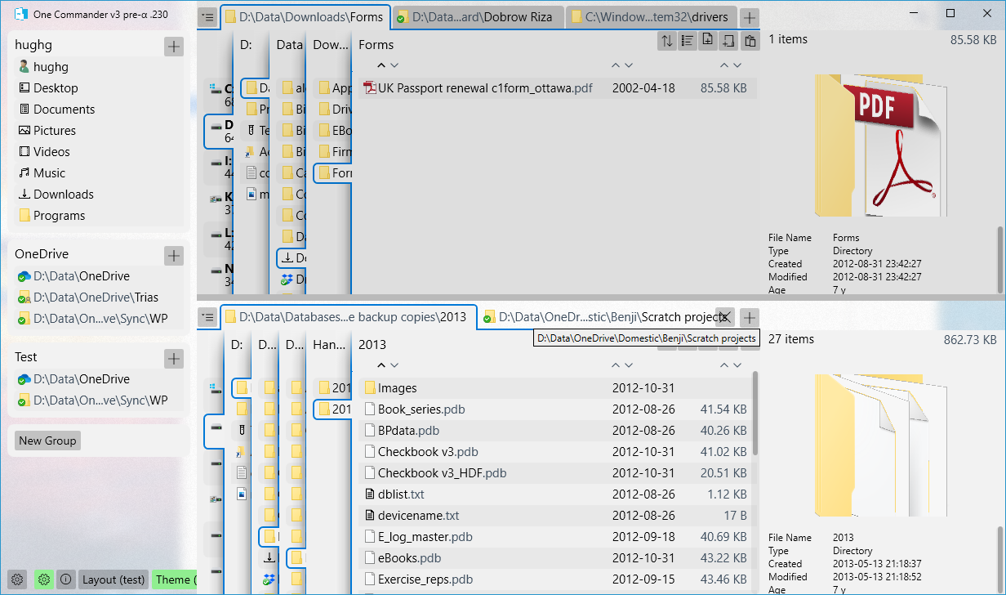
Favorites Sidebar
Top Browser
sd
Bottom Browser
Layout Button

Slide 4
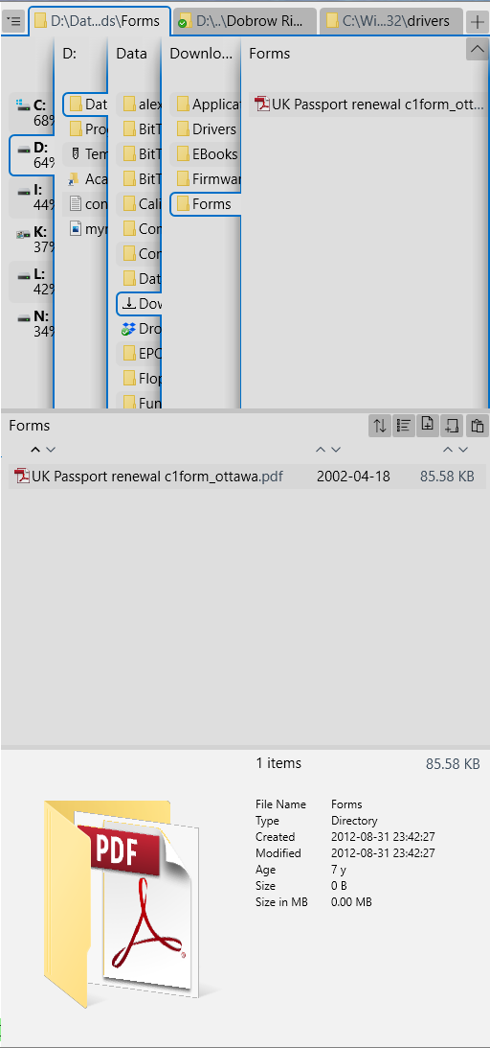
Browser Tabs
Navigation Pane
Current Folder Pane
File/Folder Details Pane

Slide 5
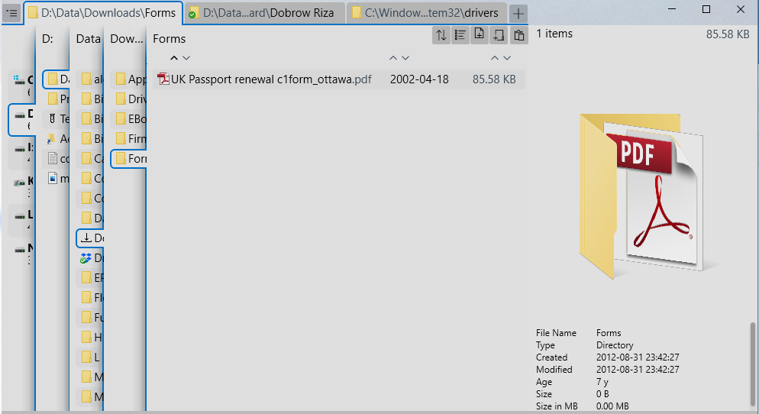
Browser Tabs
Navigation Pane
Current Folder Pane
File/Folder Details Pane

Slide 6
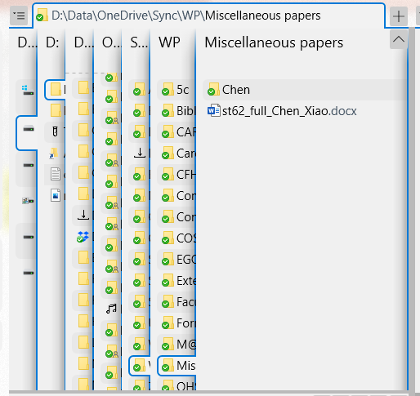
Current Folder Column

Slide 7
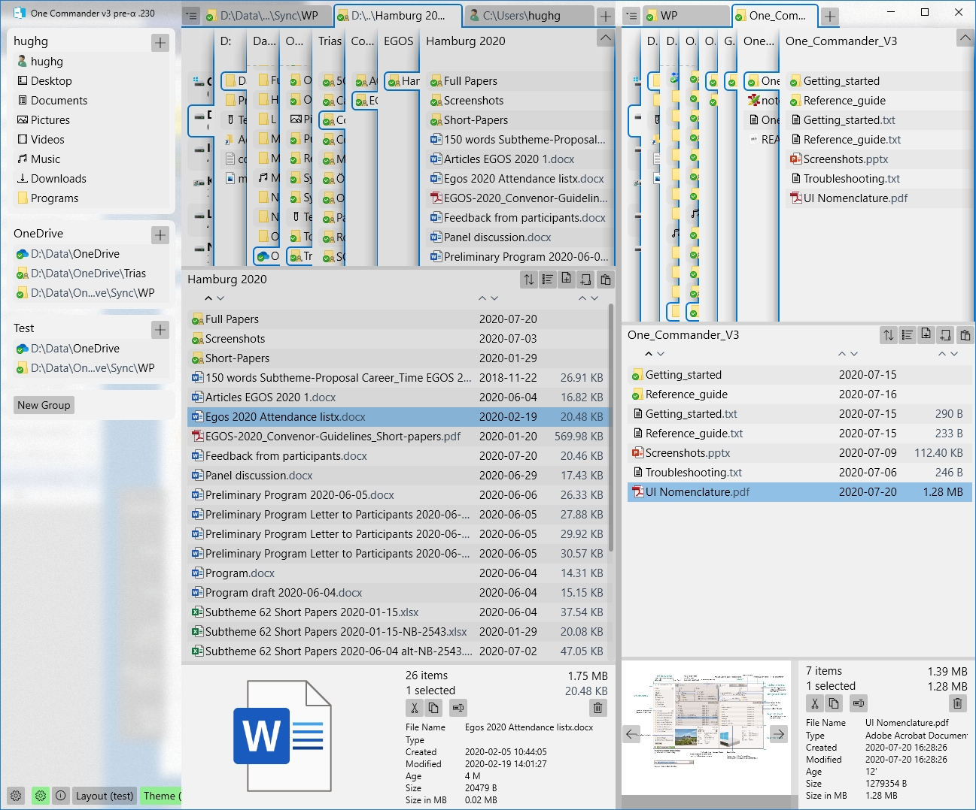
2020-07-264
Favorites Sidebar*
Left Browser
Right Browser
Title Bar Buttons
*for now
Browser Tabs
Current Folder Column
Scroll Indicator (not showing here)
Drives Column
Parent Folder Column
Path Edit Button
Right Navigation Pane
Navigation Pane Toggle Button
Favorites Group
Navigation Panes
Favorites Group Title
Add to Favorites Group Button
Folder Pane Toolbar
Sort Arrows
New Favorites Group Button
Scrollbar “Thumb” (not showing)
Context Menu: what you get when you right-click Folder or File
Current Folder Panes
Notification Pane at top or bottom
Main Toolbar? Lower Toolbar (if you need one at the top)?
Editable TextBox
Right Details Pane
Browser Divider
Details Pane resizer
Right Folder Pane
Left Details Pane Buttons
Preview Navigation Buttons
File/Folder Preview

Slide 8
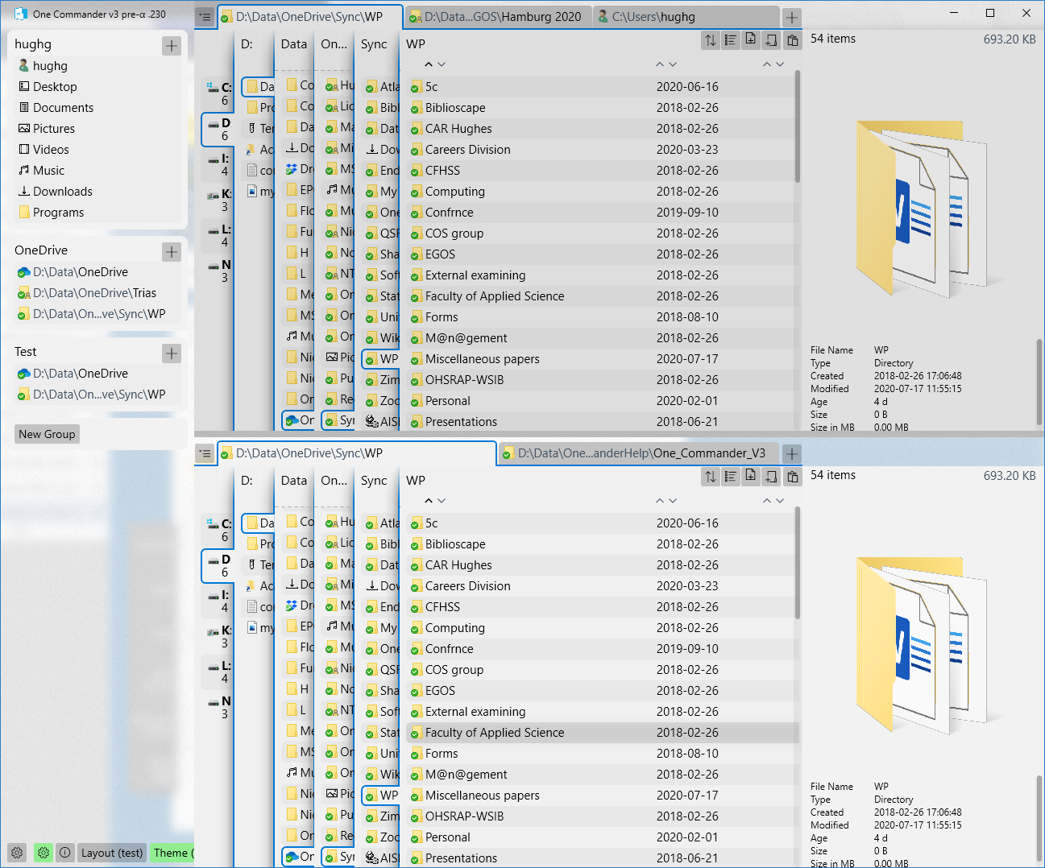
2020-07-26
Drives Column
Top Current Folder Pane
Top Details Pane
Top Browser
Bottom Browser

